Slide 1
AI-POWERED TRAVEL COMPANION
AI-Powered Interactive Smart Tourism Platform for Enhanced Traveler Experiences

Slide 2
ABSTRACT
This project introduces an AI-Powered Interactive Travel Companion designed to offer personalized, dynamic, and culturally immersive tourism experiences.
Leveraging advanced AI techniques such as image recognition, natural language processing, and recommendation systems, the platform solves challenges like overcrowding, fragmented planning, and lack of authentic discovery.
The solution integrates real-time data on weather, crowd density, and local events with seamless vendor support, enabling sustainable tourism promotion and local economic empowerment.

Slide 3
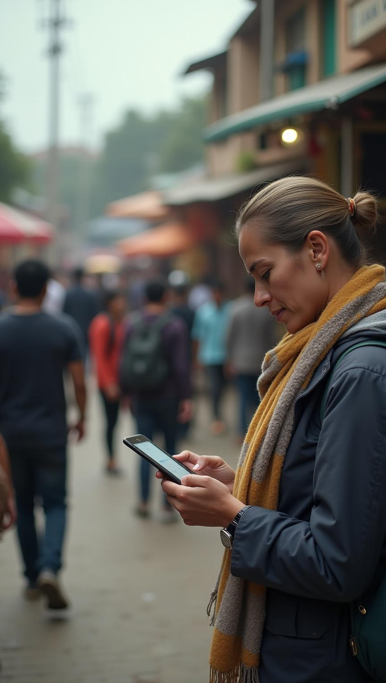
Introduction
Current Problems in Tourism:
Overcrowding in popular destinations causing environmental strain and diminished visitor experiences.
Lack of personalized travel planning tools that adapt to user preferences dynamically.
Difficulty for tourists to discover authentic local culture and hidden gems beyond mainstream attractions.
Limited digital integration for small local businesses and artisans, reducing their economic visibility.
Inadequate real-time crowd and weather information leading to inefficient itineraries.

Slide 4
LITERATURE SURVEY
PAPERS REFERRED
“AI-Powered Travel Planning: Innovations and Challenges,” Journal of Tourism Technologies, 2024.
“Visual Recognition in Cultural Heritage Tourism,” IEEE Transactions on Multimedia, 2023.
“Conversational AI for Travel Assistance,” International Journal of Human-Computer Studies, 2024.
“Sustainable Tourism and AI Integration,” Environmental Impact Journal, 2025
EXISTING SOLUTIONS
Current travel applications typically focus on discrete features like hotel bookings, static itineraries, or generic recommendations.
AI work in existing apps is often limited to basic chatbots or rudimentary recommendation algorithms that lack contextual and real-time adaptability.
Few solutions leverage integrated AI photo recognition or real-time crowd and weather data to dynamically adapt user itineraries.

Slide 5

UNIQUENESS OF THE AI-POWERED INTERACTIVE TRAVEL COMPANION
Combines AI photo recognition to reveal cultural stories from user photos, bridging visual discovery with rich context.
Integrates smart itinerary planner adapting in real-time using weather, crowd, and event information.
Promotes hidden gems and authentic cultural experiences curated through AI and community input.
Supports multiple tourism styles — adventure, relaxation, religious, and local-only — with personalized experiences.
Incorporates seamless integration for local hotels, restaurants, and vendors with zero-fee digital payments.
Includes gamified elements like contests and quizzes to engage users actively, fostering deeper cultural immersion.

Slide 6
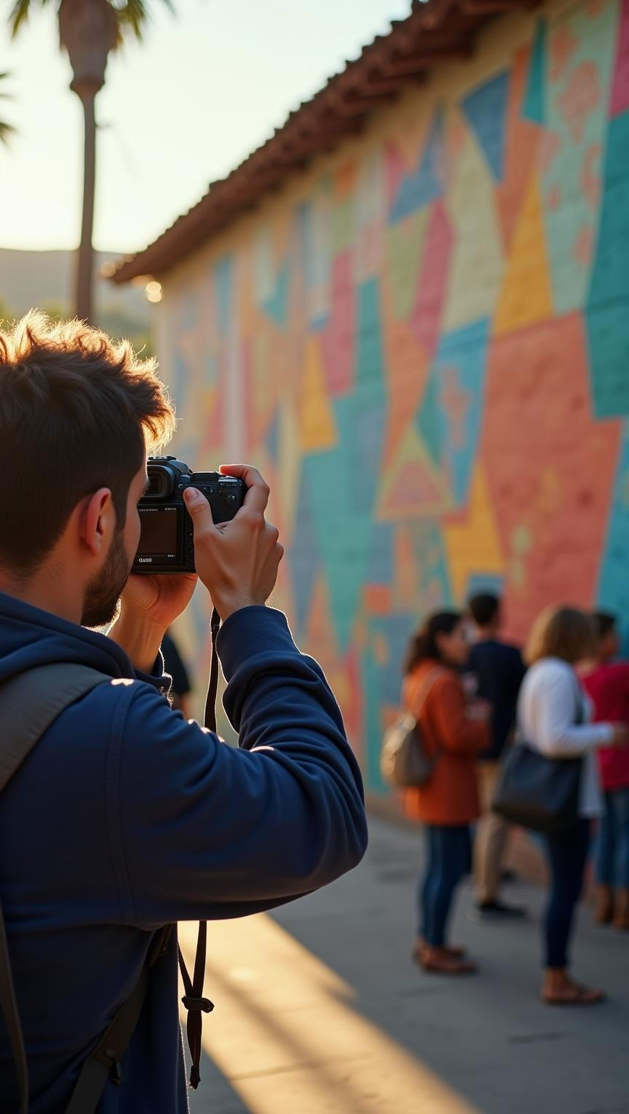
BENEFITS FOR TOURISTS
Personalized, flexible travel plans tailored to moods, preferences, and local conditions.
Deeper cultural and educational engagement from AI photo storytelling and hidden gems discovery.
Access to exclusive community experiences and interactive AR/VR tours.
Reward programs via gamification for exploring and sharing.
Reduced travel stress with automated real-time itinerary adjustments.
Enhanced safety and convenience through crowd management and offline capabilities.

Slide 7
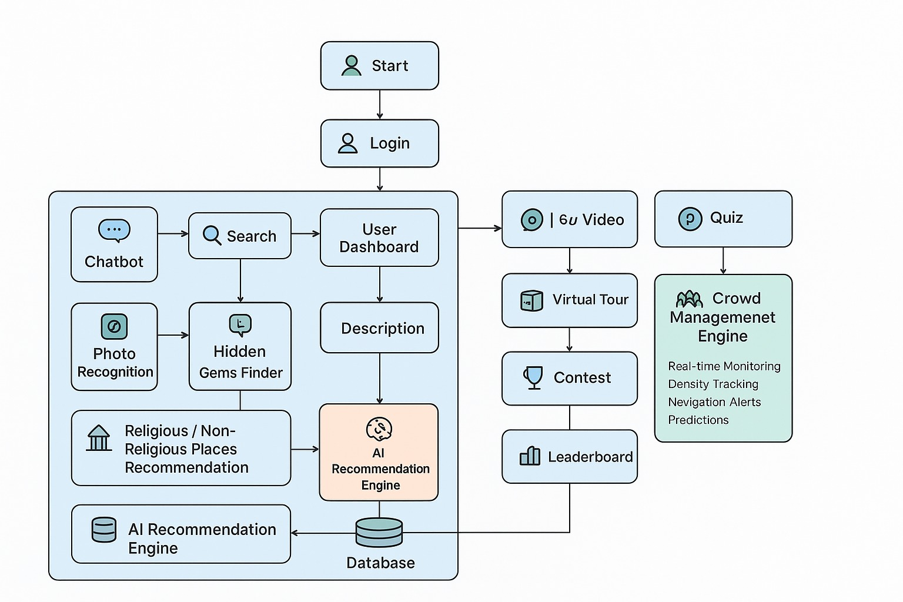
ARCHITECTURE DIAGRAM
Technologies to be Used:
Frontend: HTML, CSS, JavaScript, React.js
Backend: Python / Node.js (for AI/photo recognition & planner)
APIs: Google Maps, hotel/restaurant data, weather and crowd updates.
Methodology & Process for Implementation:
Modular web platform with dedicated AI sections: Photo Recognition, Travel Journey Designer, Hidden Gems (religious + non-religious).
Pre-trained/custom AI models for cultural/religious image recognition and personalization.
Real-time + sample datasets for attractions, businesses, events, temples, and heritage sites.
Continuous usability and scalability testing with multilingual support.

Slide 8
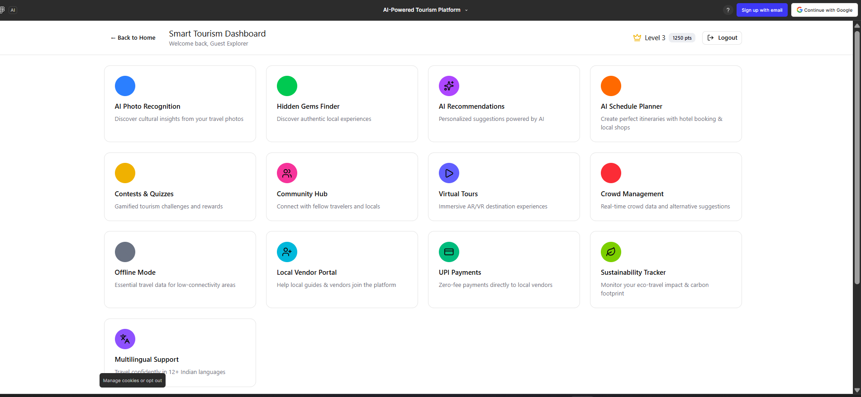
DASHBOARD OF OUR APP

Slide 9
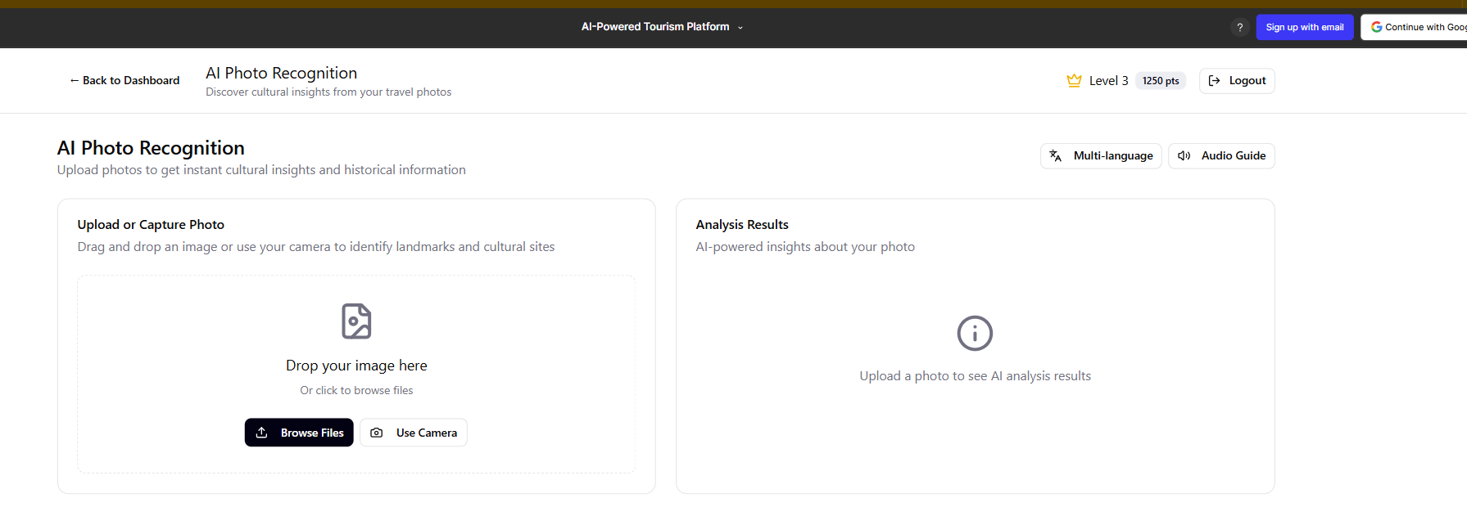
AI PHOTO RECOGNITION
Uses Convolutional Neural Networks (CNNs) in the backend to analyze user photos.
Identifies landmarks, religious symbols, artifacts, and cultural icons.
Provides historical facts, cultural stories, and related nearby experiences instantly.
Supports multilingual storytelling and augmented reality overlays for immersive learning.
Enriches traveler knowledge, making each photo an educational moment.

Slide 10
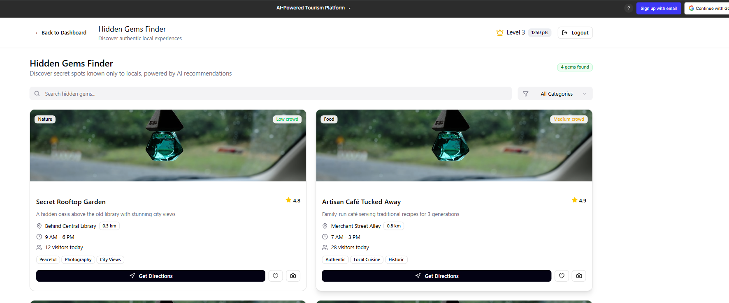
HIDDEN GEMS FINDER
Aggregates POI data from crowd-sourced content, APIs, and local partnerships.
Uses geospatial queries and real-time filters to offer lesser-known, authentic experience suggestions.
Personalizes gem discovery based on user interests and travel mode.
Dynamically updates suggestions considering weather, crowd levels, and events.
Encourages sustained tourism by distributing footfall away from crowded spots.

Slide 11
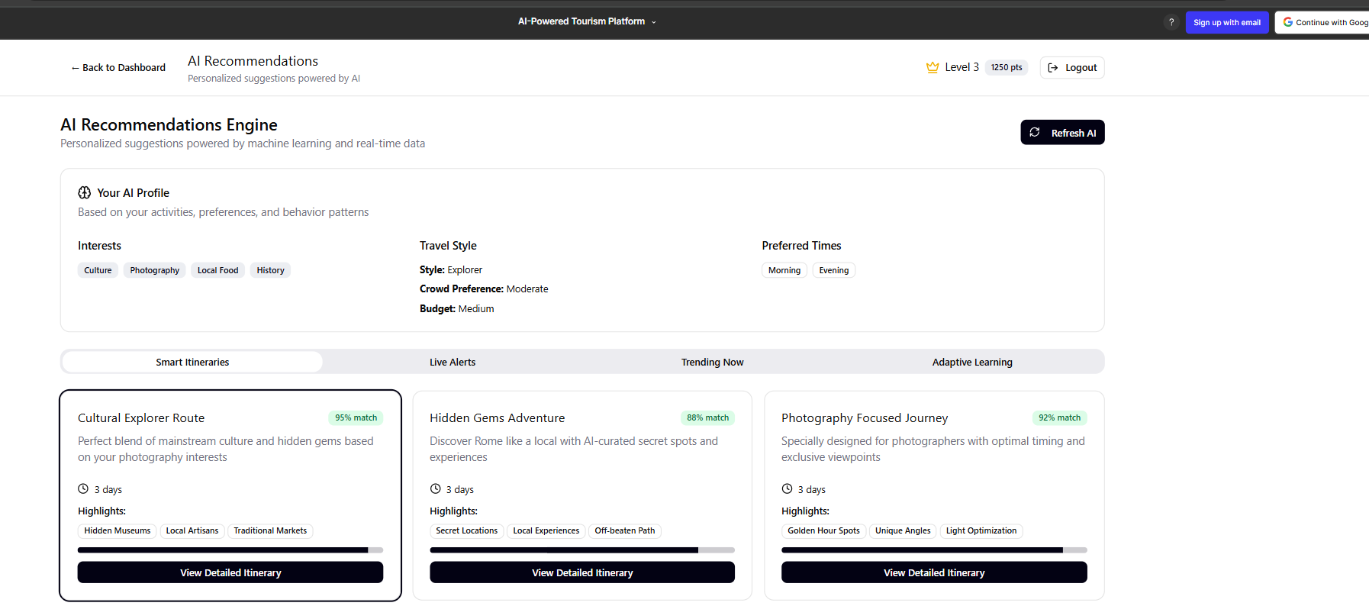
AI RECOMMENDATIONS
Employs machine learning algorithms to tailor suggestions on attractions, dining, and activities.
Learns from user behavior, preferences, and contextual factors like location and time.
Continuously refines recommendations via feedback loops.
Ensures travelers get relevant options aligned with their unique profiles.
Integrates seamlessly with other components for smooth user journey flow.

Slide 12
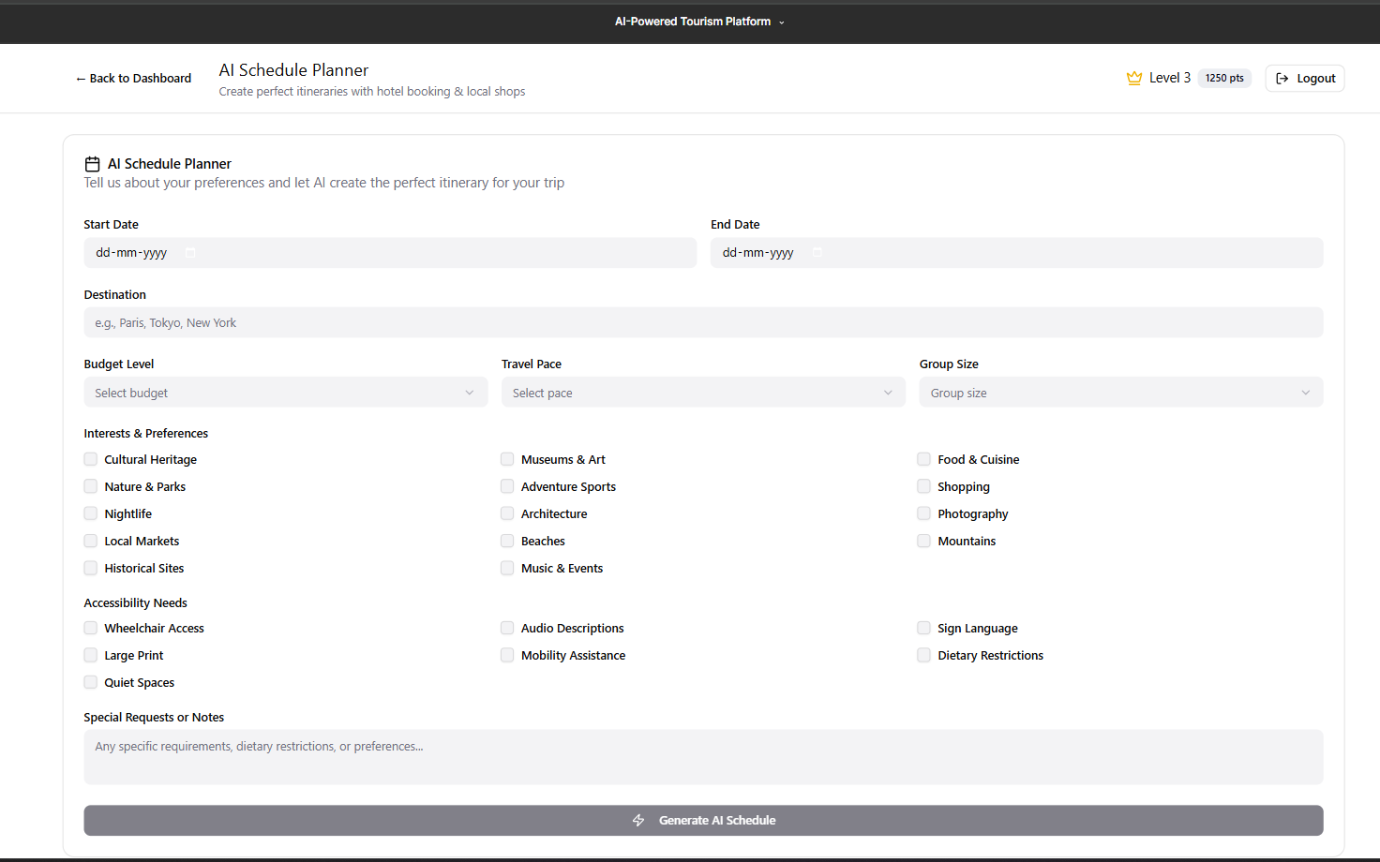
AI SCHEDULE PLANNER
Generates optimized day-wise itineraries balancing travel time, preferences, and availability.
Integrates bookings for hotels, restaurants, and local experiences directly.
Adapts itineraries dynamically with real-time updates for weather and crowd density.
Offers calendar visualization and interactive editing on frontend.
Reduces planning effort, maximizing hassle-free travel enjoyment.

Slide 13
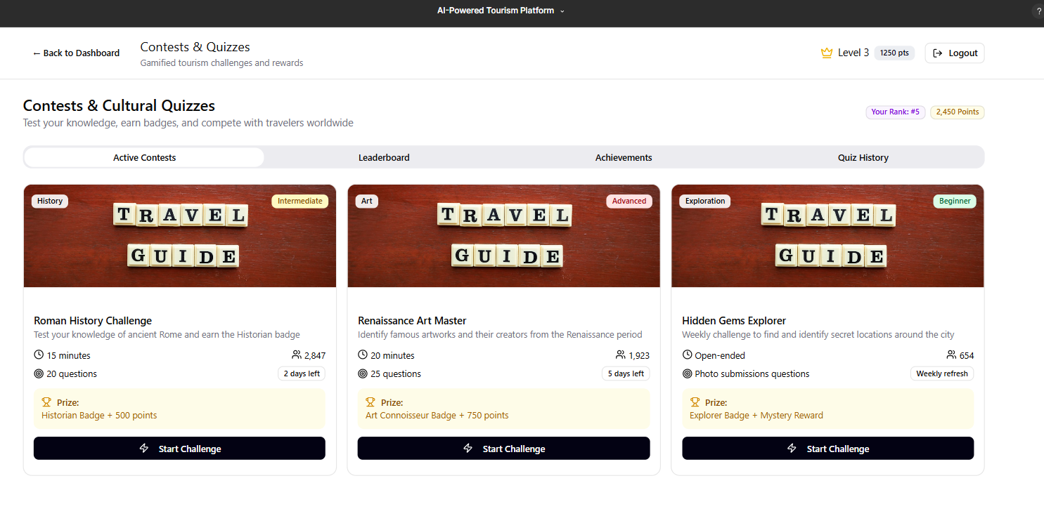
CONTESTS & QUIZZES
Gamifies cultural learning and exploration to boost engagement.
Features location-based challenges, quizzes about local heritage, and scavenger hunts.
Rewards participation with badges, discounts, and exclusive offers.
Encourages deep cultural immersion and social sharing.
Builds a vibrant, interactive travel community within the app.

Slide 14
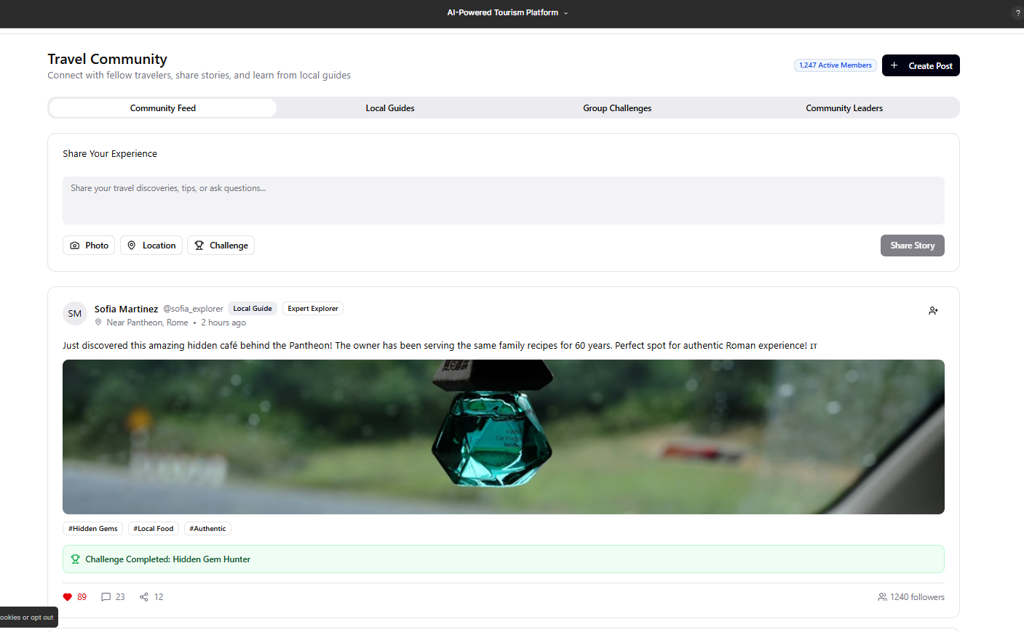
COMMUNITY HUB
Social platform connecting travelers and locals for discussions, recommendations, and meetups.
Enables sharing of travel stories, tips, photos, and event announcements.
Supports real-time messaging and group chats using WebSocket technologies.
Moderation and privacy features for safe, respectful interactions.
Fosters belonging and enriches travel experience socially.

Slide 15
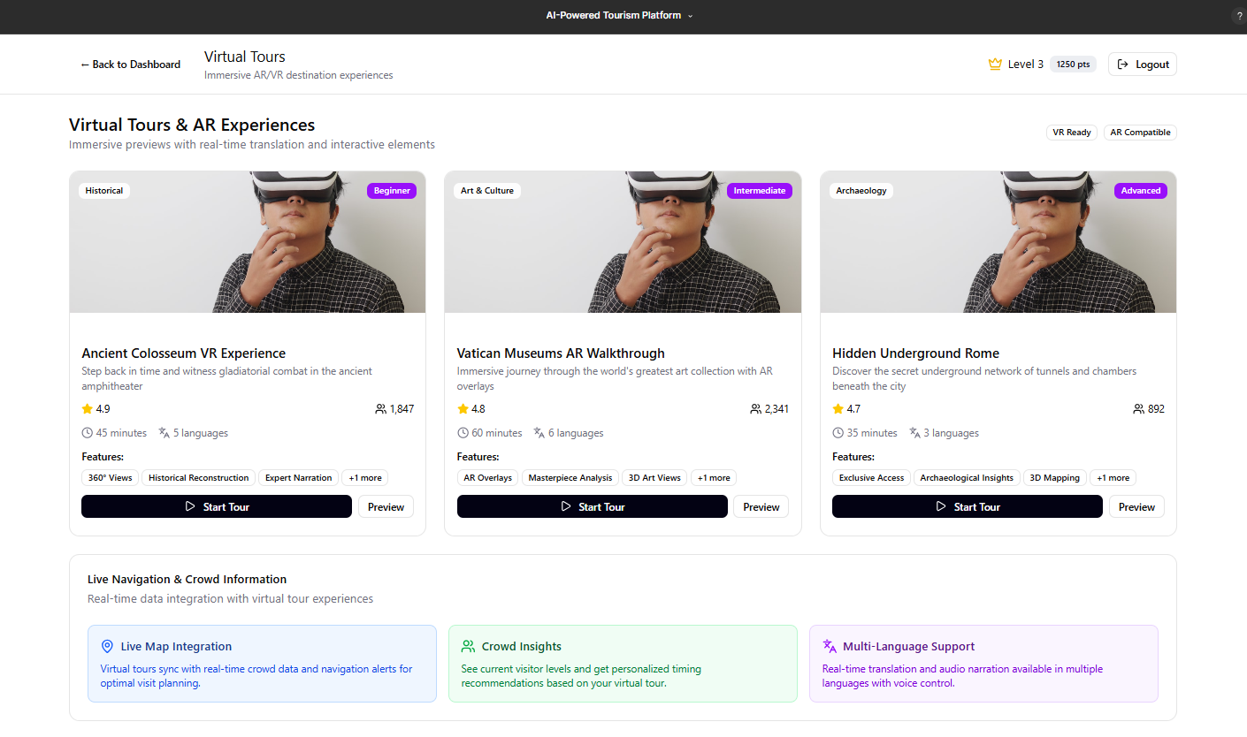
VIRTUAL TOURS & CROWD MANAGEMENT
Virtual Tours: AR/VR-powered immersive destination previews; 360-degree videos and interactive scenes.
Crowd Management: Real-time monitoring via IoT sensors and aggregated data; heatmaps and alternate route suggestions on maps.
Provides safer, more enjoyable visits while avoiding congestion.
Enables accessibility for users unable to visit physically.

Slide 16
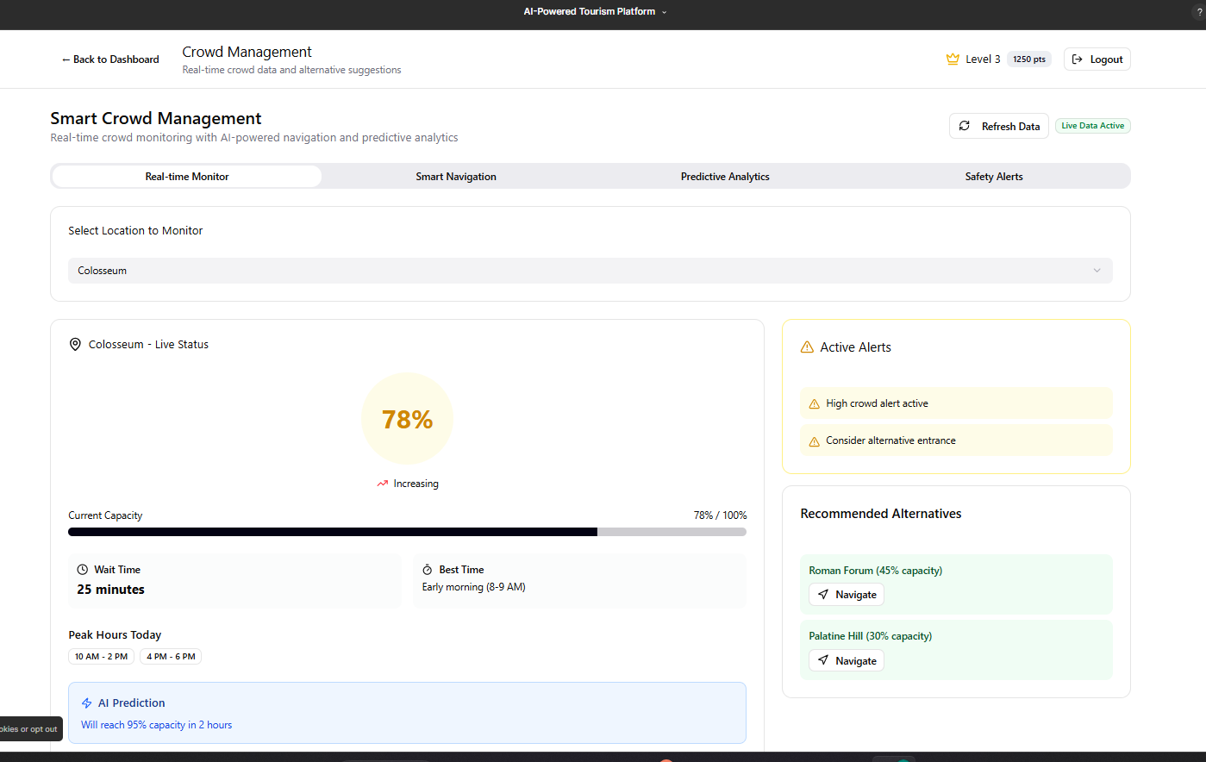
CROWD MANAGEMENT

Slide 17
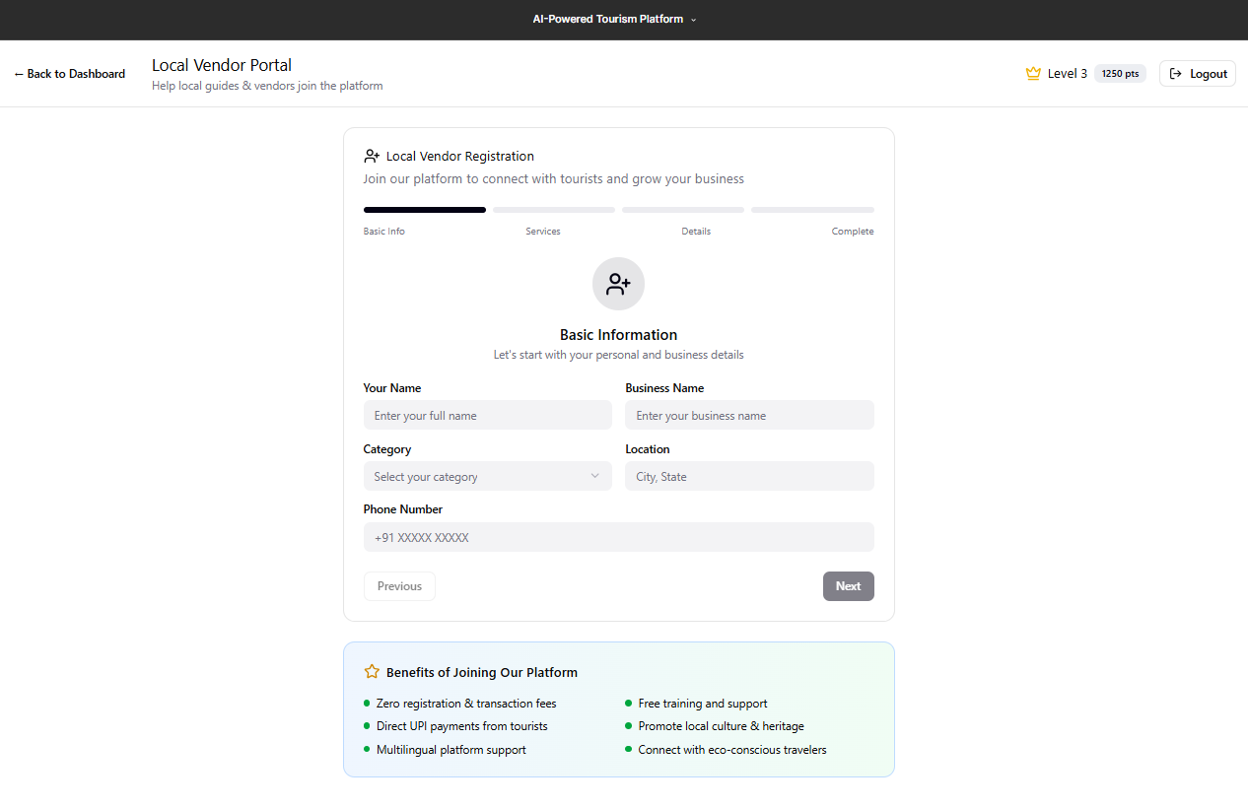
OFFLINE MODE , LOCAL VENDOR PORTAL ,UPI PAYMENTS
Offline Mode: Local caching of maps, POIs, itineraries for connectivity-poor areas.
Local Vendor Portal: Dashboard for vendors to register, manage profiles, showcase offerings.
UPI Payments: Seamless, zero-fee payments integrating popular UPI gateways for secure, direct vendor support.

Slide 18
Conclusions
The platform revolutionizes smart tourism by integrating advanced AI, cultural engagement, and sustainability to empower travelers and vendors alike.

